Slide 1
W4111 – Introduction to Databases Module II (4), NoSQL (4)
© Donald F. Ferguson, 2025

Slide 2

Contents
2 | W4111-2025S-11-Module-II-NoSql-4 © Donald F. Ferguson, 2025

Slide 3
Contents
Course update
Module II
Query optimization
Concepts
Equivalent expressions
Some examples of optimizations and explanation.
Statics and information for cost optimization computation
Transactions
Concepts
Atomicity, durability and recovery
Isolation, concurrency control and locking
Scalability
Web applications
Concepts
REST
Walkthrough of project template

Slide 4
Course Update
4 | W4111-2025S-11-Module-II-NoSql-4 © Donald F. Ferguson, 2025

Slide 5
Course Update
Midterm
We completed midterm grading. I apologize for the delay. Some TAs had unavoidable issues that caused delays.
You should be able to see your results. I edited the quiz settings this morning.
I will hold online OHs this afternoon. I would appreciate a couple of students showing me that they see from a grading and feedback perspective.
I will provide a correct answer guide annotated with what I was looking for on each question.
I am speaking with the TAs on how to handle regrades.
HW 4A
I have asked the TAs to open GradeScope for submission and provide instructions.
Only 34 students have watched the recitation that explains how to do the assignment.
I am working on HW 5
I will incrementally publish tasks for the project starting this weekend. This will give us a chance to do the project step by step.
I will publish the written questions according to the schedule I provided in the previous update.

Slide 6
Module II – DBMS Architecture and Implementation
6 | W4111-2025S-11-Module-II-NoSql-4 © Donald F. Ferguson, 2025

Slide 7

Module II – DBMS Architecture and Implementation
Overview and Reminder
7 | W4111-2025S-11-Module-II-NoSql-4 © Donald F. Ferguson, 2025

Slide 8
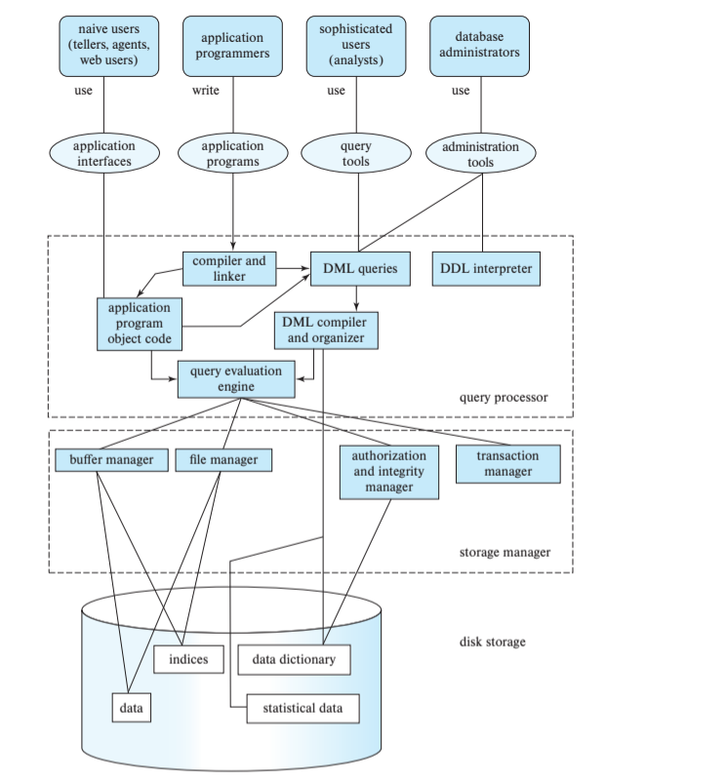
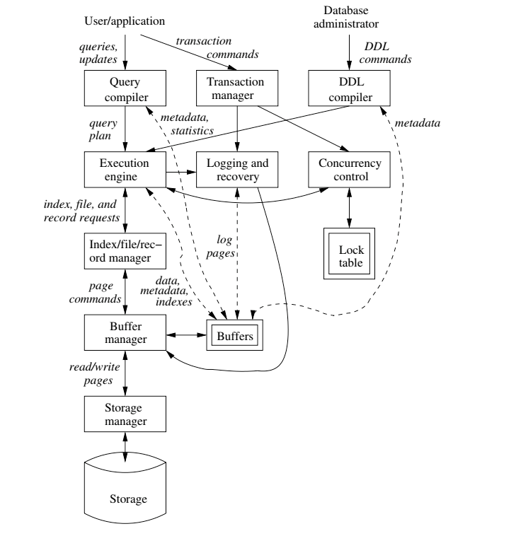
DBMS Arch.

Slide 9

Data Management
Database Systems: The Complete Book (2nd Edition) by Hector Garcia-Molina (Author), Jeffrey D. Ullman (Author), Jennifer Widom (Author)

Slide 10
Query Processing Overview Reminder
10 | W4111-2025S-11-Module-II-NoSql-4 © Donald F. Ferguson, 2025

Slide 11
Basic Steps in Query Processing
1. Parsing and translation
2. Optimization
3. Evaluation

Slide 12
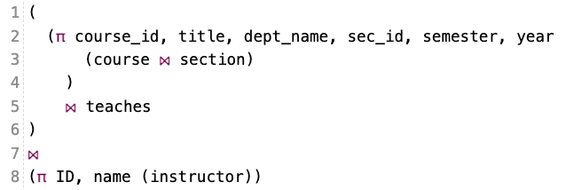
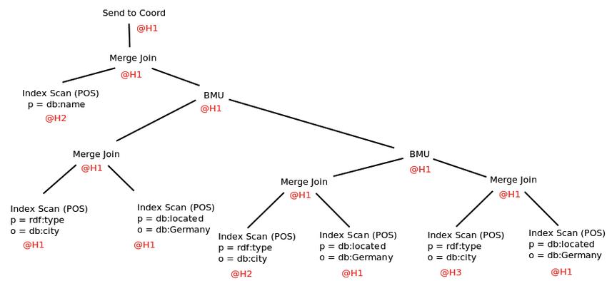
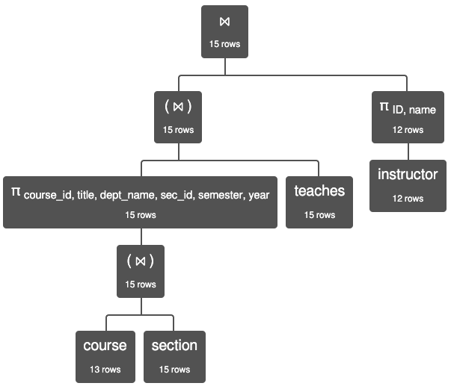
Query Processing

Slide 14
Basic Steps in Query Processing: Optimization
A relational algebra expression may have many equivalent expressions
E.g., σ_{salary<75000}(∏_{salary}(instructor)) is equivalent to ∏_{salary}(σ_{salary<75000}(instructor))
Each relational algebra operation can be evaluated using one of several different algorithms
Correspondingly, a relational-algebra expression can be evaluated in many ways.
Annotated expression specifying detailed evaluation strategy is called an evaluation-plan. E.g.,:
Use an index on salary to find instructors with salary < 75000,
Or perform complete relation scan and discard instructors with salary ≥ 75000

Slide 15
Query Optimization
15 | W4111-2025S-11-Module-II-NoSql-4 © Donald F. Ferguson, 2025

Slide 16
Outline
Introduction
Transformation of Relational Expressions
Catalog Information for Cost Estimation
Statistical Information for Cost Estimation
Cost-based optimization
Dynamic Programming for Choosing Evaluation Plans
Materialized views

Slide 17
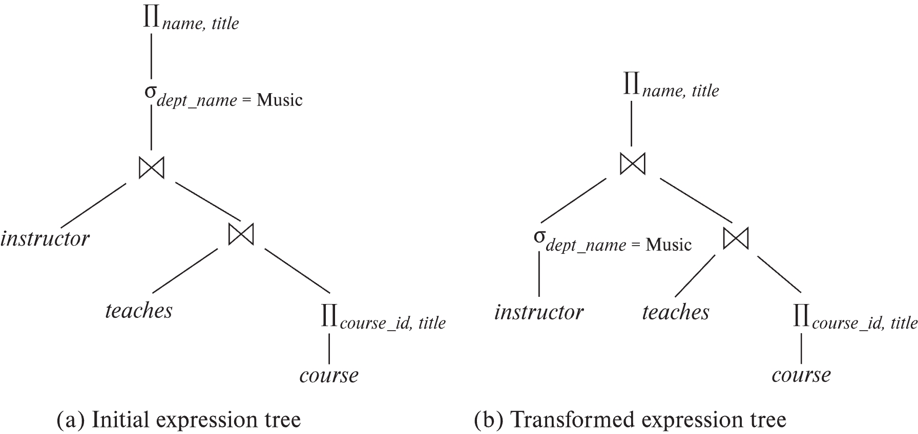
Introduction
Alternative ways of evaluating a given query
Equivalent expressions
Different algorithms for each operation

Slide 18
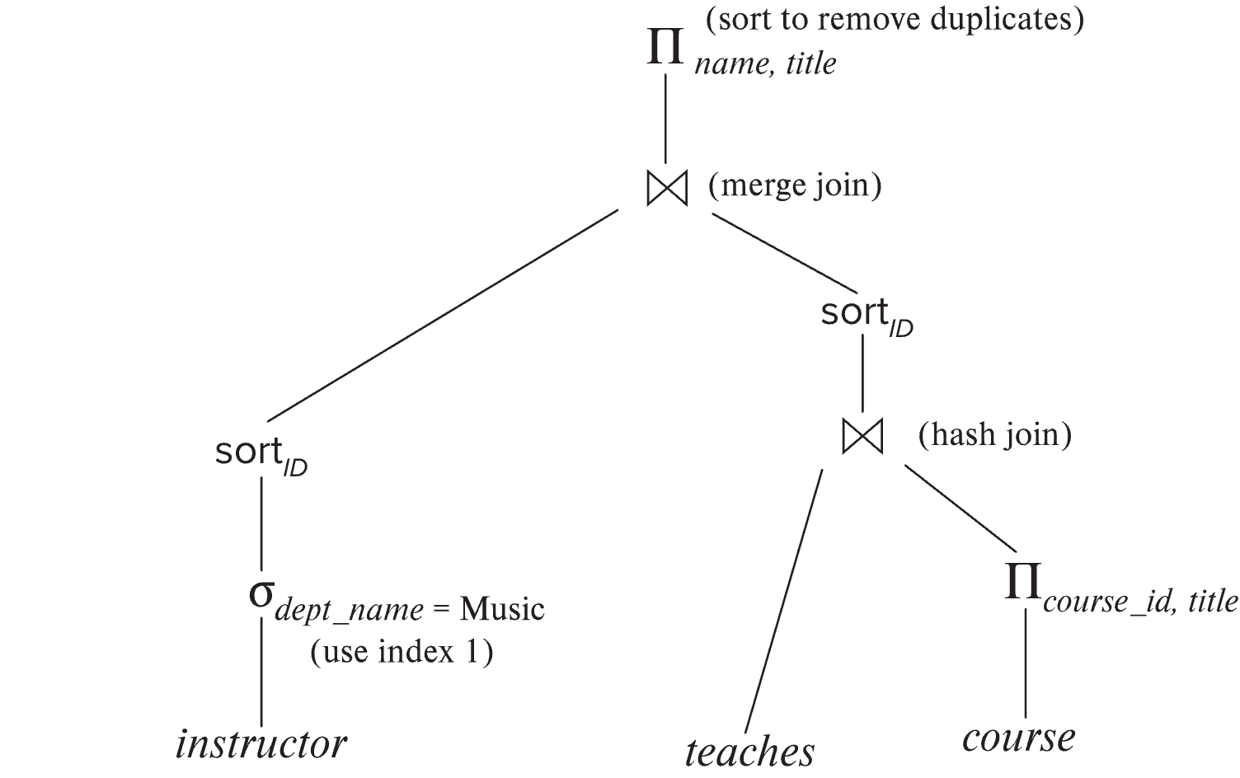
Introduction (Cont.)
An evaluation plan defines exactly what algorithm is used for each operation, and how the execution of the operations is coordinated.
Find out how to view query execution plans on your favorite database

Slide 19
Introduction (Cont.)
Cost difference between evaluation plans for a query can be enormous
E.g., seconds vs. days in some cases
Steps in cost-based query optimization
1. Generate logically equivalent expressions using equivalence rules
2. Annotate resultant expressions to get alternative query plans
3. Choose the cheapest plan based on estimated cost
Estimation of plan cost based on:
Statistical information about relations. Examples:
number of tuples, number of distinct values for an attribute
Statistics estimation for intermediate results
to compute cost of complex expressions
Cost formulae for algorithms, computed using statistics

Slide 20
Viewing Query Evaluation Plans
Most database support explain <query>
Displays plan chosen by query optimizer, along with cost estimates
Some syntax variations between databases
Oracle: explain plan for <query> followed by select * from table (dbms_xplan.display)
SQL Server: set showplan_text on
Some databases (e.g. PostgreSQL) support explain analyse <query>
Shows actual runtime statistics found by running the query, in addition to showing the plan
Some databases (e.g. PostgreSQL) show cost as f..l
f is the cost of delivering first tuple and l is cost of delivering all results
DFF Note: Show EXPLAIN in MySQLWorkbench

Slide 21
Generating Equivalent Expressions

Slide 22
Transformation of Relational Expressions
Two relational algebra expressions are said to be equivalent if the two expressions generate the same set of tuples on every legal database instance
Note: order of tuples is irrelevant
we don’t care if they generate different results on databases that violate integrity constraints
In SQL, inputs and outputs are multisets of tuples
Two expressions in the multiset version of the relational algebra are said to be equivalent if the two expressions generate the same multiset of tuples on every legal database instance.
An equivalence rule says that expressions of two forms are equivalent
Can replace expression of first form by second, or vice versa

Slide 23
Equivalence Rules
1. Conjunctive selection operations can be deconstructed into a sequence of individual selections. σ_{θ1 ∧ θ2} (E) ≡ σ_{θ1} (σ_{θ2} (E))
2. Selection operations are commutative. σ_{θ1}(σ_{θ2}(E)) ≡ σ_{θ2} (σ_{θ1}(E))
3. Only the last in a sequence of projection operations is needed, the others can be omitted. ∏ _{L1}(∏ _{L2}(…(∏ _{Ln}(E))…)) ≡ ∏ _{L1}(E) where L₁ ⊆ L₂ … ⊆ L_{n}
4. Selections can be combined with Cartesian products and theta joins.
σ_{θ} (E₁ x E₂) ≡ E₁ ⨝ _{θ} E₂
σ _{θ1} (E₁ ⨝_{θ2} E₂) ≡ E₁ ⨝ _{θ1∧θ2} E₂

Slide 24
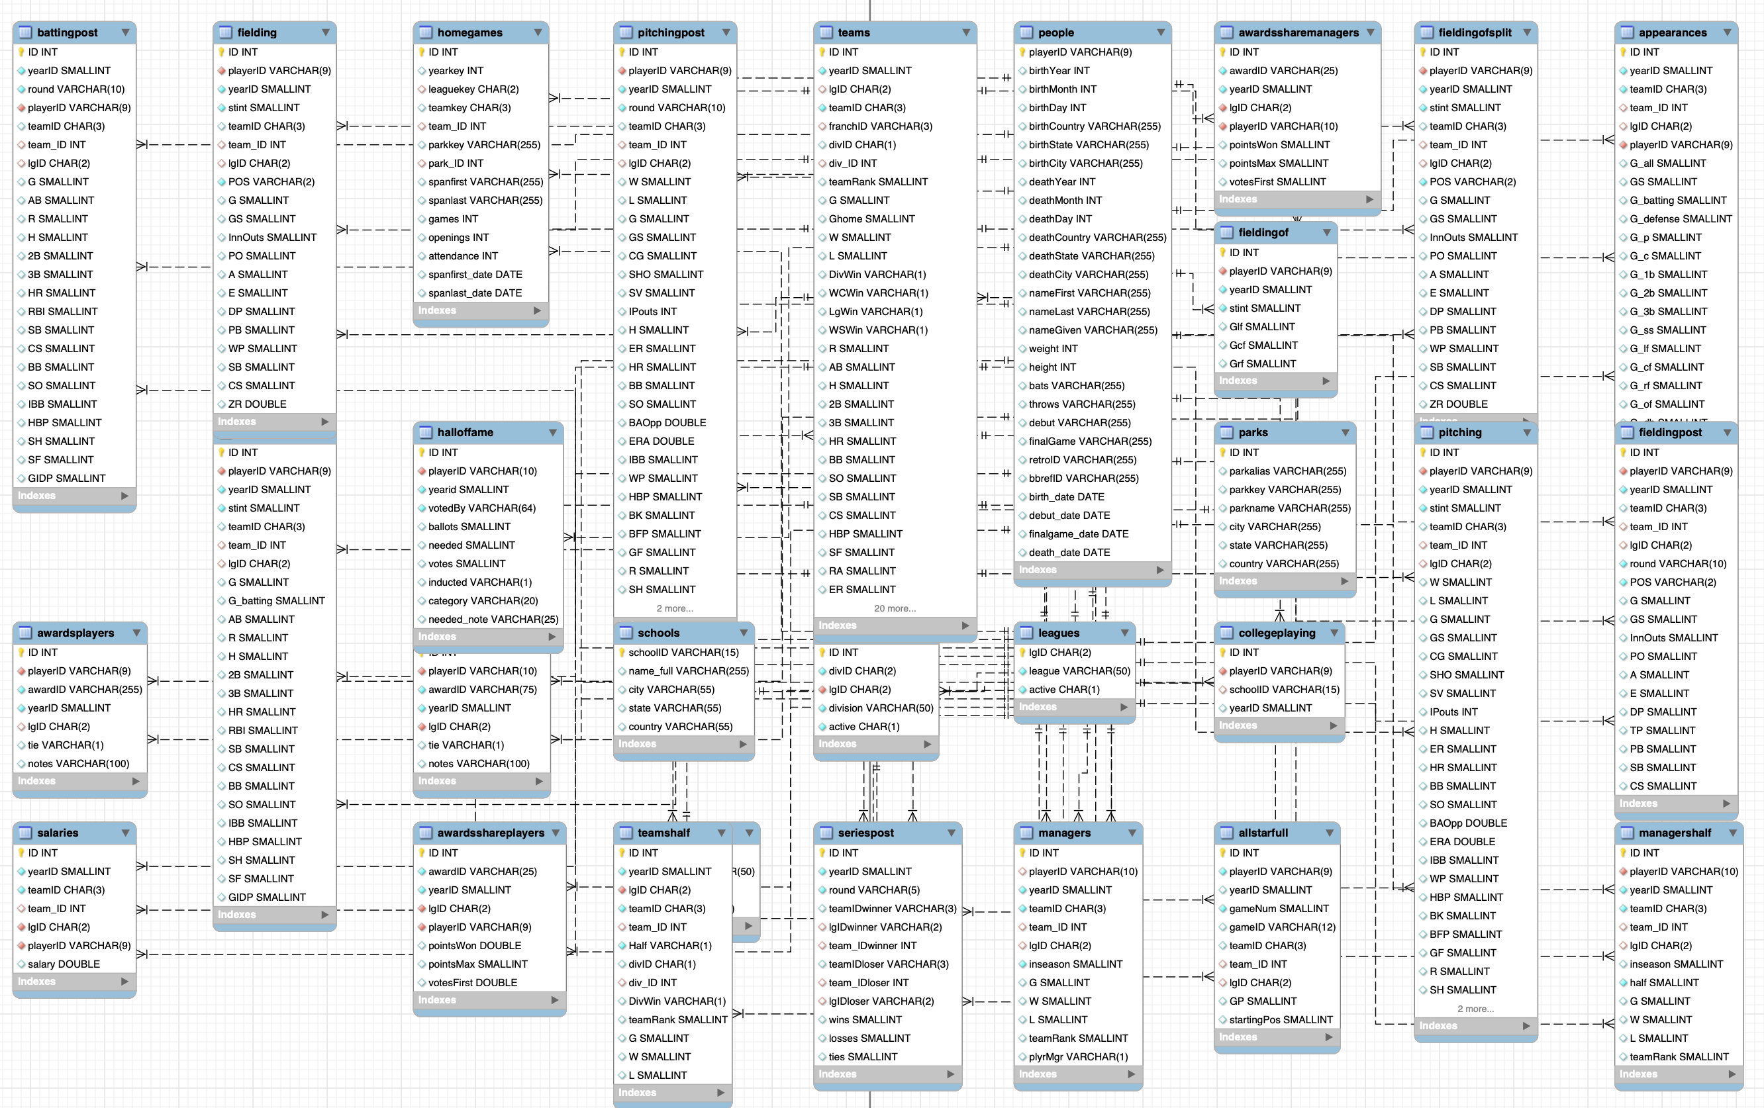
Lahman Baseball Database

Slide 25
Explanation
σ_{θ1 ∧ θ2} (E) ≡ σ_{θ1} (σ_{θ2} (E)) –
What is going on here?
Why wouldn’t we just go through the table with one scan?
Consider Lahman’s Baseball Database
select * from people where throws="L" and nameLast="Williams";
people has about 20K rows ➔ a simple scan cost is O(20K)
Assume there is an index on throws and an index on nameLast.
The engine could first use the index to get matching rows producing a smaller table, and then scan the smaller result set. But which index?
Most Selective Index
select count(*) as no_of_rows, count(distinct nameLast) as nameLastValue, count(distinct throws) as throwsValues, count(*)/count(distinct nameLast) as nameLastSelectivity, count(*)/count(distinct throws) as throwsSelectivity from people;

Slide 26
Equivalence Rules (Cont.)
5. Theta-join operations (and natural joins) are commutative. E₁ ⨝ E₂ ≡ E₂ ⨝ E₁
6. (a) Natural join operations are associative:
(E₁ ⨝ E₂) ⨝ E₃ ≡ E₁ ⨝ (E₂ ⨝ E₃) (b) Theta joins are associative in the following manner: (E₁ ⨝ _{θ1} E₂) ⨝ _{θ2 ∧ θ3} E₃ ≡ E₁ ⨝_{θ1 ∧ θ3} (E₂ ⨝ _{θ2} E₃) where θ₂ involves attributes from only E₂ and E₃.
These make sense when you realize having the smaller table on the right can improve performance.
This one only makes sense when you understand another rule covered in a couple of slides.

Slide 27
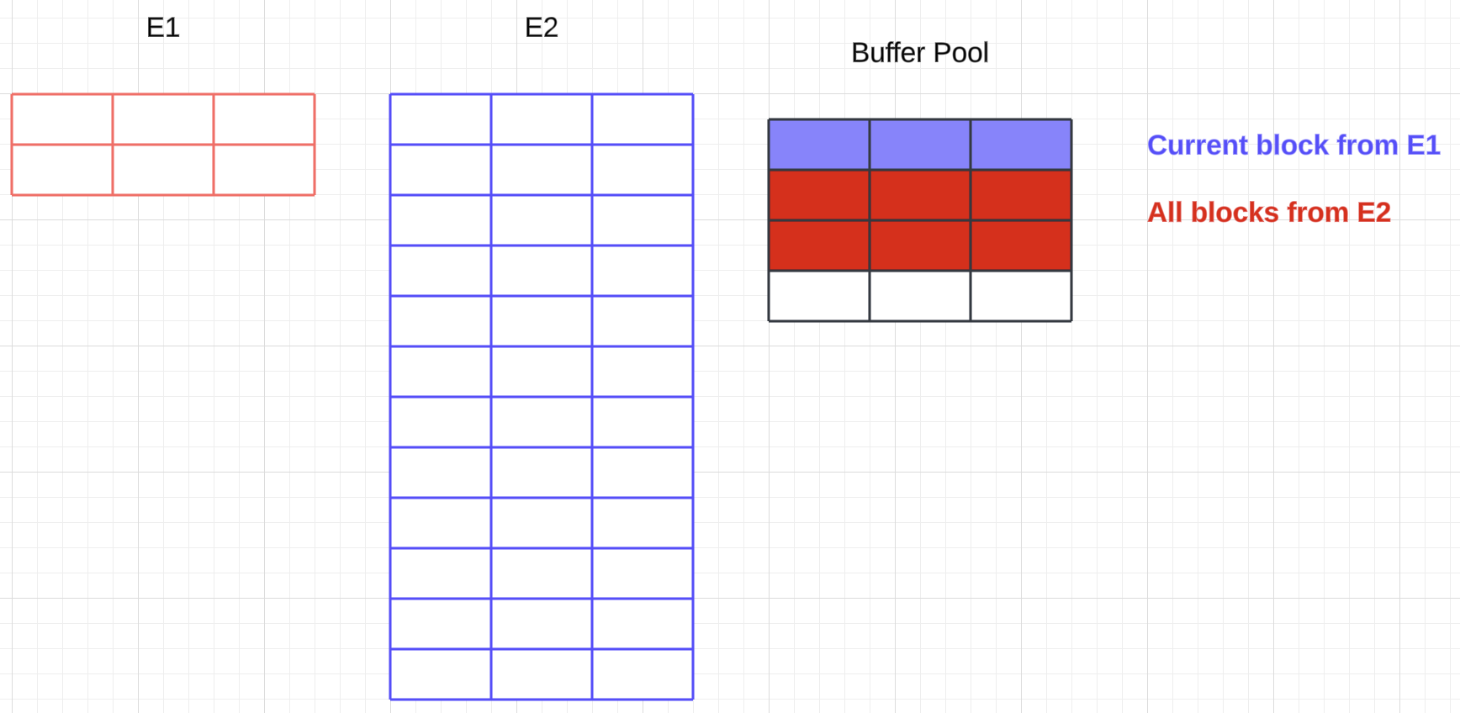
Explanation
E₁ ⨝ E₂ ≡ E₂ ⨝ E₁
Assume there are no indexes ➔ Nested loop join ➔
The engine scans the left table one time.
The engine scans the right table once for each row in the left table.
If one of the tables is (much) smaller than the other, the engine prefers scanning the smaller table because it is more efficient WRT to buffer pool usage.
Extreme example
E₁ ⨝ E₂ reads 2 blocks from E₁ and access 2*12 blocks from E_{2 ,}
But the engine can only have 2 or 3 in the buffer pool ➔
Approximately 2 + 24/3 = 10 block Ios.
E₂ ⨝ E₁ accesses 12 blocks from E₂ and 12*2 blocks from E₁
But all of E₁ fits in the buffer pool ➔ 14 block I/Os

Slide 28
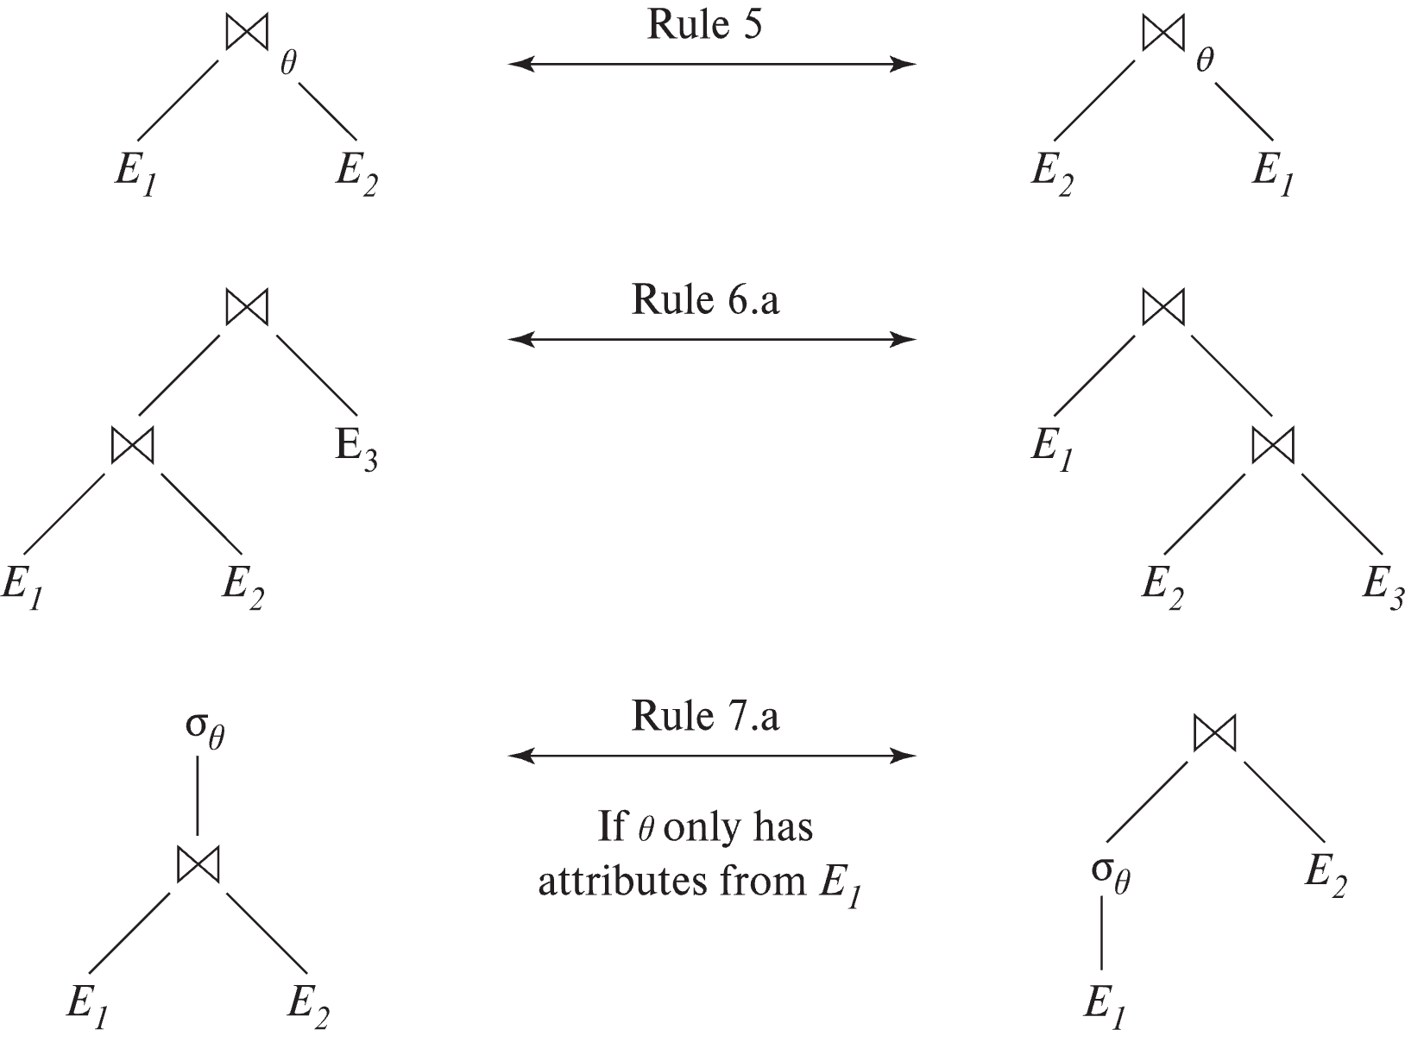
Pictorial Depiction of Equivalence Rules

Slide 29
Equivalence Rules (Cont.)
7. The selection operation distributes over the theta join operation under the following two conditions: (a) When all the attributes in θ₀ involve only the attributes of one of the expressions (E₁) being joined. σ_{θ0} (E₁ ⨝_{θ} E₂) ≡ (σ_{θ0}(E₁)) ⨝_{θ} E₂
(b) When θ₁ involves only the attributes of E₁ and θ₂ involves only the attributes of E₂.
σ_{θ1 ∧ θ2} (E₁ ⨝_{θ} E₂) ≡ (σ_{θ1}(E₁)) ⨝_{θ} (σ_{θ2}(E₂))

Slide 30
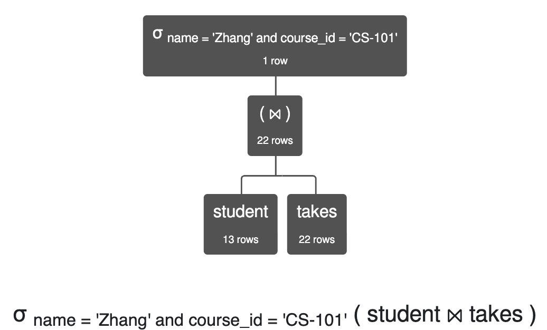
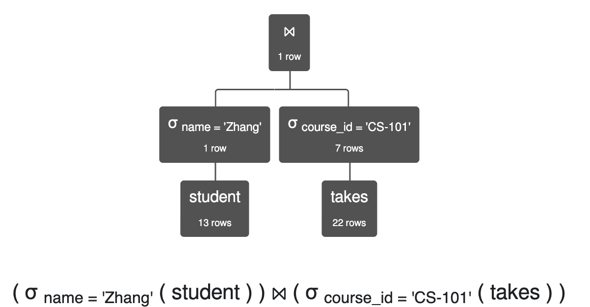
Explanation
σ_{θ1 ∧ θ2} (E₁ ⨝_{θ} E₂) ≡ (σ_{θ1}(E₁)) ⨝_{θ} (σ_{θ2}(E₂))
σ name='Zhang' ∧ course_id='CS-101' (student ⨝ takes) is equivalent to (σ name='Zhang' (student)) ⨝ (σ course_id='CS-101' (takes))
Simplistically, the cost is:
(Join) 13 * 22 +
(Scan) 22
Simplistically, the cost is:
(Two scans) 13 + 22 +
(Join) 1 * 7

Slide 31
Equivalence Rules (Cont.)
8. The projection operation distributes over the theta join operation as follows:
(a) if θ involves only attributes from L₁ ∪ L₂: ∏ _{L1 ∪ L2}(E₁ ⨝_{θ} E₂) ≡ ∏ _{L1}(E₁) ⨝_{θ} ∏ _{L2}(E₂)
(b) In general, consider a join E₁ ⨝_{θ} E₂.
Let L₁ and L₂ be sets of attributes from E₁ and E₂, respectively.
Let L₃ be attributes of E₁ that are involved in join condition θ, but are not in L₁ ∪ L₂, and
let L₄ be attributes of E₂ that are involved in join condition θ, but are not in L₁ ∪ L₂. ∏ _{L1 ∪ L2}(E₁ ⨝_{θ} E₂) ≡ ∏ _{L1 ∪ L2}(∏ _{L1 ∪ L3}(E₁) ⨝_{θ} ∏ _{L2 ∪ L4}(E₂))
Similar equivalences hold for outerjoin operations: ⟕, ⟖, and ⟗
Think about this rule … …
The project makes the buffer pool consumption smaller, and
I can combine the rule with commutativity (from above).

Slide 32
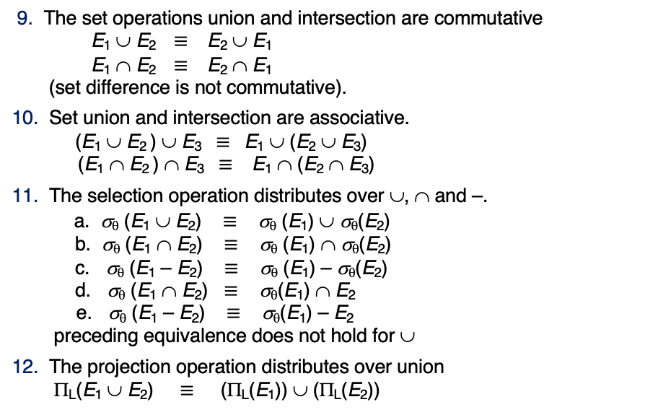
Equivalence Rules (Cont.)
9. The set operations union and intersection are commutative E₁ ∪ E₂ ≡ E₂ ∪ E₁ E₁ ∩ E₂ ≡ E₂ ∩ E₁ (set difference is not commutative).
10. Set union and intersection are associative. (E₁ ∪ E₂ ) ∪ E₃ ≡ E₁ ∪ (E₂ ∪ E₃) (E₁ ∩ E₂ ) ∩ E₃ ≡ E₁ ∩ (E₂ ∩ E₃)
11. The selection operation distributes over ∪, ∩ and –. a. σ_{θ} (E₁ ∪ E₂) ≡ σ_{θ} (E₁) ∪ σ_{θ}(E₂) b. σ_{θ} (E₁ ∩ E₂) ≡ σ_{θ} (E₁) ∩ σ_{θ}(E₂) c. σ_{θ} (E₁ – E₂) ≡ σ_{θ} (E₁) – σ_{θ}(E₂) d. σ_{θ} (E₁ ∩ E₂) ≡ σ_{θ}(E₁) ∩ E₂ e. σ_{θ} (E₁ – E₂) ≡ σ_{θ}(E₁) – E₂ preceding equivalence does not hold for ∪
12. The projection operation distributes over union Π_{L}(E₁ ∪ E₂) ≡ (Π_{L}(E₁)) ∪ (Π_{L}(E₂))
I will take their word for it.

Slide 33

Equivalence Rules (Cont.)
13. Selection distributes over aggregation as below σ_{θ}(_{G}𝛾_{A}(E)) ≡ _{G}𝛾_{A}(σ_{θ}(E)) provided θ only involves attributes in G
14. a. Full outerjoin is commutative: E₁ ⟗ E₂ ≡ E₂ ⟗ E₁ b. Left and right outerjoin are not commutative, but: E₁ ⟕ E₂ ≡ E₂ ⟖ E₁
15. Selection distributes over left and right outerjoins as below, provided θ₁
only involves attributes of E₁ a. σ_{θ1} (E₁ ⟕_{θ} E₂) ≡ (σ_{θ1} (E₁)) ⟕_{θ} E₂ b. σ_{θ1} (E₁ ⟖_{θ} E₂) ≡ E₂ ⟕_{θ} (σ_{θ1} (E₁))
16. Outerjoins can be replaced by inner joins under some conditions
a. σ_{θ1} (E₁ ⟕_{θ} E₂) ≡ σ_{θ1} (E₁ ⨝_{θ} E₂) b. σ_{θ1} (E₁ ⟖_{θ} E₁) ≡ σ_{θ1} (E₁ ⨝_{θ} E₂) provided θ₁ is null rejecting on E₂
Oh good. More rules.

Slide 34
Equivalence Rules (Cont.)
Note that several equivalences that hold for joins do not hold for outerjoins
σ_{year=2017}(instructor ⟕ teaches) ≢ σ_{year=2017}(instructor ⨝ teaches)
Outerjoins are not associative (r ⟕ s) ⟕ t ≢ r ⟕ (s ⟕ t)
e.g. with r(A,B) = {(1,1), s(B,C) = { (1,1)}, t(A,C) = { }
Notes:
How about (r ⟕ s) ⟕ t vs (r ⟕ t) ⟕ s assuming r has common attributes with s and t? Hint: consider 2 cases where s and t have common attributes and those where they have no common attribute

Slide 35
Transformation Example: Pushing Selections
Query: Find the names of all instructors in the Music department, along with the titles of the courses that they teach
Π_{name, title}(σ_{dept_name= ‘Music’} (instructor ⨝ (teaches ⨝ Π_{course_id, title} (course))))
Transformation using rule 7a.
Π_{name, title}((σ_{dept_name= ‘Music’}(instructor)) ⨝ (teaches ⨝ Π_{course_id, title} (course)))
Performing the selection as early as possible reduces the size of the relation to be joined.

Slide 36
Join Ordering Example
For all relations r_{1,} r_{2,} and r₃,
(r₁ ⨝ r₂) ⨝ r₃ = r₁ ⨝ (r₂ ⨝ r₃ )
(Join Associativity) ⨝
If r₂ ⨝ r₃ is quite large and r₁ ⨝ r₂ is small, we choose
(r₁ ⨝ r₂) ⨝ r₃
so that we compute and store a smaller temporary relation.

Slide 37
Join Ordering Example (Cont.)
Consider the expression
Π_{name, title}(σ_{dept_name= “Music”} (instructor) ⨝ teaches) ⨝ Π_{course_id, title} (course))))
Could compute teaches ⨝ Π_{course_id, title} (course) first, and join result with σ_{dept_name= “Music”} (instructor) but the result of the first join is likely to be a large relation.
Only a small fraction of the university’s instructors are likely to be from the Music department
it is better to compute
σ_{dept_name= “Music”} (instructor) ⨝ teaches
first.

Slide 38
Enumeration of Equivalent Expressions
Query optimizers use equivalence rules to systematically generate expressions equivalent to the given expression
Can generate all equivalent expressions as follows:
Repeat
apply all applicable equivalence rules on every subexpression of every equivalent expression found so far
add newly generated expressions to the set of equivalent expressions
Until no new equivalent expressions are generated above
The above approach is very expensive in space and time
Two approaches
Optimized plan generation based on transformation rules
Special case approach for queries with only selections, projections and joins

Slide 39

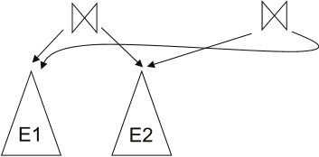
Implementing Transformation Based Optimization
Space requirements reduced by sharing common sub-expressions:
when E1 is generated from E2 by an equivalence rule, usually only the top level of the two are different, subtrees below are the same and can be shared using pointers
E.g., when applying join commutativity
Same sub-expression may get generated multiple times
Detect duplicate sub-expressions and share one copy
Time requirements are reduced by not generating all expressions
Dynamic programming
We will study only the special case of dynamic programming for join order optimization

Slide 40
Cost Estimation
Cost of each operator computer as described in Chapter 15
Need statistics of input relations
E.g., number of tuples, sizes of tuples
Inputs can be results of sub-expressions
Need to estimate statistics of expression results
To do so, we require additional statistics
E.g., number of distinct values for an attribute
More on cost estimation later
Remember algorithm selection applies to the operators in each of the possible trees.

Slide 41
Choice of Evaluation Plans
Must consider the interaction of evaluation techniques when choosing evaluation plans
choosing the cheapest algorithm for each operation independently may not yield best overall algorithm. E.g.
merge-join may be costlier than hash-join, but may provide a sorted output which reduces the cost for an outer level aggregation.
nested-loop join may provide opportunity for pipelining
Practical query optimizers incorporate elements of the following two broad approaches:
1. Search all the plans and choose the best plan in a cost-based fashion.
2. Uses heuristics to choose a plan.

Slide 42

Join Order Optimization Algorithm
procedure findbestplan(S) if (bestplan[S].cost ≠ ∞) return bestplan[S] // else bestplan[S] has not been computed earlier, compute it now if (S contains only 1 relation) set bestplan[S].plan and bestplan[S].cost based on the best way of accessing S using selections on S and indices (if any) on S else for each non-empty subset S1 of S such that S1 ≠ S P1= findbestplan(S1) P2= findbestplan(S - S1) for each algorithm A for joining results of P1 and P2 … compute plan and cost of using A (see next page) .. if cost < bestplan[S].cost bestplan[S].cost = cost bestplan[S].plan = plan; return bestplan[S]

Slide 43
Statistics for Cost Estimation

Slide 44
Statistical Information for Cost Estimation
n_{r}: number of tuples in a relation r.
b_{r}: number of blocks containing tuples of r.
l_{r}: size of a tuple of r.
f_{r}: blocking factor of r — i.e., the number of tuples of r that fit into one block.
V(A, r): number of distinct values that appear in r for attribute A; same as the size of ∏_{A}(r).
If tuples of r are stored together physically in a file, then:

Slide 45
Histograms
Histogram on attribute age of relation person
Equi-width histograms
Equi-depth histograms break up range such that each range has (approximately) the same number of tuples
E.g. (4, 8, 14, 19)
Many databases also store n most-frequent values and their counts
Histogram is built on remaining values only

Slide 46
Histograms (cont.)
Histograms and other statistics usually computed based on a random sample
Statistics may be out of date
Some database require a analyze command to be executed to update statistics
Others automatically recompute statistics
e.g., when number of tuples in a relation changes by some percentage

Slide 47
Selection Size Estimation
σ_{A=v}(r)
n_{r} / V(A,r) : number of records that will satisfy the selection
Equality condition on a key attribute: size estimate = 1
σ_{A≤V}(r) (case of σ_{A ≥ V}(r) is symmetric)
Let c denote the estimated number of tuples satisfying the condition.
If min(A,r) and max(A,r) are available in catalog
c = 0 if v < min(A,r)
c =
If histograms available, can refine above estimate
In absence of statistical information c is assumed to be n_{r} / 2.

Slide 48
Size Estimation of Complex Selections
The selectivity of a condition θ_{i} is the probability that a tuple in the relation r satisfies θ_{i} .
If s_{i} is the number of satisfying tuples in r, the selectivity of θ_{i} is given by s_{i} /n_{r}.
Conjunction: σ_{θ1∧ θ2∧. . . ∧ θn} (r). Assuming independence, estimate of tuples in the result is:
Disjunction:σ_{θ1∨} _{θ2 ∨. . . ∨} _{θn} (r). Estimated number of tuples:
Negation: σ_{¬θ}(r). Estimated number of tuples: n_{r} – size(σ_{θ}(r))

Slide 49
Summary
49 | W4111-2025S-11-Module-II-NoSql-4 © Donald F. Ferguson, 2025

Slide 50
Summary
That was painful, but … …
I used 33 slides but only used some of them for mocking and humor.
Chapter 16 has 86 slides and I skipped the complex ones.
And wait until you see transactions. That will make you long for the simplicity of query optimization.
There are a handful of interrelated techniques the optimize can use:
Equivalent expressions.
Algorithm selection.
Parallelism for CPU and I/O.
Pipelining versus materialization.
Any questions on exams will focus on your ability to think through the concepts, not memorize all of the rules and techniques.

Slide 51
Transactions and Recovery
51 | W4111-2025S-11-Module-II-NoSql-4 © Donald F. Ferguson, 2025

Slide 52
Core Concepts
52 | W4111-2025S-11-Module-II-NoSql-4 © Donald F. Ferguson, 2025

Slide 53
Core Transaction Concept is ACID Properties
http://slideplayer.com/slide/9307681
ACID
Atomic
“ALL OR NOTHING”
Transaction cannot be subdivided
Consistent
Transaction → transforms database from one consistent state to another consistent state
Isolated
Transactions execute independently of one another
Database changes not revealed to users until after transaction has completed
Durable
Database changes are permanent
The permanence of the database’s consistent state

Slide 54
ACID Properties (httpwww.tutorialspoint.com/dbms/dbms_transaction.htm)
A transaction is a very small unit of a program and it may contain several low-level tasks. A transaction in a database system must maintain Atomicity, Consistency, Isolation, and Durability − commonly known as ACID properties − in order to ensure accuracy, completeness, and data integrity.
Atomicity − This property states that a transaction must be treated as an atomic unit, that is, either all of its operations are executed or none. There must be no state in a database where a transaction is left partially completed. States should be defined either before the execution of the transaction or after the execution/abortion/failure of the transaction.
Consistency − The database must remain in a consistent state after any transaction. No transaction should have any adverse effect on the data residing in the database. If the database was in a consistent state before the execution of a transaction, it must remain consistent after the execution of the transaction as well.
Durability − The database should be durable enough to hold all its latest updates even if the system fails or restarts. If a transaction updates a chunk of data in a database and commits, then the database will hold the modified data. If a transaction commits but the system fails before the data could be written on to the disk, then that data will be updated once the system springs back into action.
Isolation − In a database system where more than one transaction are being executed simultaneously and in parallel, the property of isolation states that all the transactions will be carried out and executed as if it is the only transaction in the system. No transaction will affect the existence of any other transaction.

Slide 55
Transaction Concept
A transaction is a unit of program execution that accesses and possibly updates various data items.
E.g., transaction to transfer $50 from account A to account B:
BEGIN TRANSACTION {
1. read(A)
2. A := A – 50
write(A)
4. read(B)
5. B := B + 50
write(B)
COMMIT or ROLLBACK }
Two main issues to deal with:
Failures of various kinds, such as hardware failures and system crashes
Concurrent execution of multiple transactions
Transfer(to_a, from_b, amount)

Slide 56
Example of Fund Transfer
T
Transaction to transfer $50 from account A to account B:
1. read(A)
2. A := A – 50
3. write(A)
4. read(B)
5. B := B + 50
6. write(B)
Atomicity requirement
If the transaction fails after step 3 and before step 6, money will be “lost” leading to an inconsistent database state
Failure could be due to software or hardware
The system should ensure that updates of a partially executed transaction are not reflected in the database
Durability requirement — once the user has been notified that the transaction has completed (i.e., the transfer of the $50 has taken place), the updates to the database by the transaction must persist even if there are software or hardware failures.
B
C

Slide 57
Example of Fund Transfer (Cont.)
Consistency requirement in above example:
The sum of A and B is unchanged by the execution of the transaction
In general, consistency requirements include
Explicitly specified integrity constraints such as primary keys and foreign keys
Implicit integrity constraints
e.g., sum of balances of all accounts, minus sum of loan amounts must equal value of cash-in-hand
A transaction must see a consistent database.
During transaction execution the database may be temporarily inconsistent.
When the transaction completes successfully the database must be consistent
Erroneous transaction logic can lead to inconsistency

Slide 58
Example of Fund Transfer (Cont.)
Isolation requirement — if between steps 3 and 6, another transaction T2 is allowed to access the partially updated database, it will see an inconsistent database (the sum A + B will be less than it should be).
T1 T2
1. read(A)
2. A := A – 50
write(A) 1. read(A)
2. read(B) 3. print(“A = “, A, “B=“, B, “Total=“, A+B)
4. read(B)
5. B := B + 50
6. write(B)
Isolation can be ensured trivially by running transactions serially
That is, one after the other.
However, executing multiple transactions concurrently has significant benefits, as we will see later.
T1, T2
T1
T2

Slide 59
ACID Properties
A transaction is a unit of program execution that accesses and possibly updates various data items. To preserve the integrity of data the database system must ensure:
Atomicity. Either all operations of the transaction are properly reflected in the database or none are.
Consistency. Execution of a transaction in isolation preserves the consistency of the database.
Isolation. Although multiple transactions may execute concurrently, each transaction must be unaware of other concurrently executing transactions. Intermediate transaction results must be hidden from other concurrently executed transactions.
That is, for every pair of transactions T_{i} and T_{j}, it appears to T_{i} that either T_{j}, finished execution before T_{i} started, or T_{j} started execution after T_{i} finished.
Durability. After a transaction completes successfully, the changes it has made to the database persist, even if there are system failures.

Slide 60
Transaction State
Active – the initial state; the transaction stays in this state while it is executing
Partially committed – after the final statement has been executed.
Failed -- after the discovery that normal execution can no longer proceed.
Aborted – after the transaction has been rolled back and the database restored to its state prior to the start of the transaction. Two options after it has been aborted:
Restart the transaction
Can be done only if no internal logical error
Kill the transaction
Committed – after successful completion.

Slide 61
Atomicity Durability
61 | W4111-2025S-11-Module-II-NoSql-4 © Donald F. Ferguson, 2025

Slide 62
Atomicity
A transaction is a logical unit of work that must be either entirely completed or entirely undone. (All writes happen or none of them happen)
OK. What does this mean? Consider some pseudo-code
def transfer(source_acct_id, target_acct_id, amount)
Check that both accounts exist.
IF is_checking_account(source_acct_id)
Check that (source_acct.balance-amount) > source_account.overdraft_limit
ELSE
Check that (source_count.balance-amount) >source_account.minimum_balance
Update source account
Update target account.
INSERT a record into transfer tracking table.

Slide 63
Atomicity
A transaction is a logical unit of work that must be either entirely completed or entirely undone. (All writes happen or none of them happen)
OK. What does this mean? Consider some pseudo-code
def transfer(source_acct_id, target_acct_id, amount)
Check that both accounts exist.
IF is_checking_account(source_acct_id)
Check that (source_acct.balance-amount) > source_account.overdraft_limit
ELSE
Check that (source_count.balance-amount) >source_account.minimum_balance
Update source account
Update target account.
INSERT a record into transfer tracking table.
Computer or DB Server fails.

Slide 64
Atomicity
Transaction programs and databases are fast (milliseconds). What are the chances of the failure occurring in the wrong spot?
Well, that doesn’t really matter. If it happens,
Someone lost money and
There is no record off it. Someone is going to very upset.
Even a small server can have thousands of concurrent transactions ➔
There will be corruptions because some transaction will be in the wrong place at the wrong time.
Unless we do something in the DBMS
Because HW and software inevitably fail
And sadly, SW is especially prone to failure when under load

Slide 65
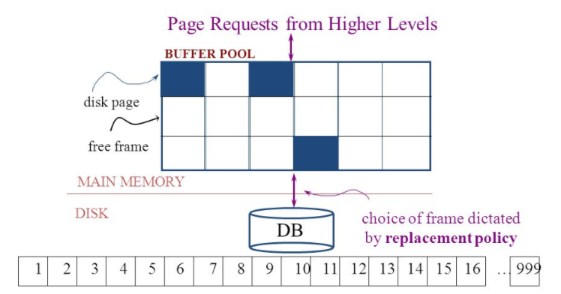
Simplistic Approach
Begin
Update A
Update B
Update C
Commit (REQ)
Force to disk
Commit (RSP)

Slide 66
Simplistic Approach
There are several problems with the simplistic approach.
The approach does not solve the problem
Some writes might succeed.
Some might be interrupted by the failure or require retry.
Writes may be random and scattered. N updates might
Change a few bytes in N data frames
A few bytes in M index frames
Transaction rate becomes bottlenecked by write I/O rate, even though a relatively small number of bytes change/transaction.
Written frames must be held in memory.
Lots of transactions
Randomly writing small pieces of lots of frames.
Consumes lots of memory with pinned pages.
Degrades the performance and optimization of the buffer.
The optimal buffer replacement policy wants to hold frames that will be reused.
Not frames that have been touched and never reused.

Slide 67
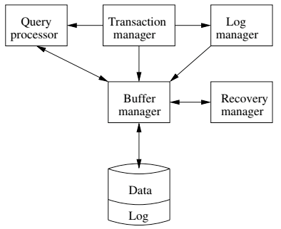
DBMS ACID Implementation
Implementation Subsystems
Query processor schedules and executes queries.
Buffer manager controls reading/writing blocks/frames to/from disk.
Log manager journals/records events to disk (log), e.g.
Transaction start/commit/abort
Transaction update of a block and previous value of data.
Transaction manager coordinates query scheduling, buffer read/write and logging to ensure ACID.
Recovery manager processes log to ensure ACID even after transaction or system failures.
Log is a special type of block file used by the system to optimize performance and ensure ACID.
Garcia-Molina et al., p. 846

Slide 68
Logging
The DBMS logs every transaction event
Log Sequence Number (LSN): A unique ID for a log record.
Prev LSN: A link to their last log record.
Transaction ID number.
Type: Describes the type of database log record.
Update Log Record
PageID: A reference to the Page ID of the modified page.
Length and Offset: Length in bytes and offset of the page are usually included.
Before and After Images of records.
Compensation Log Record
Commit Record
Abort Record Checkpoint Record
Completion Record notes that all work has been done for this particular transaction.

Slide 69
Write Ahead Logging
Begin
Update A
Update B
Update C
Commit (REQ)
Force to disk
Commit (RSP)
DBMS (Redo processing)
Write log events from all transactions into a single log stream.
Multiple events per page
Forces (writes) log record on COMMIT/ABORT
Single block I/O records many updates
Versus multiple block I/Os, each recording a single change.
All of a transaction’s updates recorded in one I/O versus many.
If there is a failure
DBMS sequentially reads log.
Applies changes to modified pages that were not saved to disk.
Then resumes normal processing.
Log

Slide 70
Write Ahead Logging
Force every write to disk?
Poor response time.
But provides durability.
Steal buffer-pool frames from uncommitted transactions?
If not, poor performance/caching performance
If yes, how can we ensure atomicity? Uncommitted updates on disk
DBMS (Undo processing)
Enable steal policy to improve cache performance by
Avoiding lots of pinned pages
Unlikely to be reused soon.
Before stealing
Force log record to disk.
Update log entry has data record
Before image
After image
If there is a failure
DBMS sequentially reads log.
Undoes changes to
modified pages, uncommitted pages
That were saved to disk.
Then resumes normal processing.
No Steal
Steal
Force
Trivial
No Force
Desired

Slide 71
ARIES Algorithm = Algorithms for Recovery and Isolation Exploiting Semantics
ARIES recovery involves three passes
Analysis pass:
Determine which transactions to undo
Determine which pages were dirty (disk version not up to date) at time of
RedoLSN: LSN from which redo should start
Redo pass:
Repeats history, redoing all actions from RedoLSN (updated committed but not written changes to pages)
RecLSN and PageLSNs are used to avoid redoing actions already reflected on page
Undo pass:
Rolls back all incomplete transactions (with uncommitted pages written to disk).
Transactions whose abort was complete earlier are not undone

Slide 72
Durability
Write changes to disk trivially achieves durability.
DBMS engine uses write-ahead-logging to
Achieve durability
But with better performance through more efficient caching and I/O.
Well, disks fail. How is that durable.
RAID and other solutions.
Disk subsystems, including entire RAID device, fail →
Duplex writes
To independent disk subsystems.
Well, there are earthquakes, floods, etc.

Slide 73
Availability and Replication
There are two basic patterns
Active/Passive
All requests go to master during normal processing.
Updates are transactionally queued for processing at passive backup.
Failure of master
Routes subsequent requests to backup.
Backup must process and commit updates before accepting requests.
Active/Active
Both environments process requests.
Some form of distributed transaction commit required to synchronize updates on both copies.
Multi-system communication to guarantee consistency is the foundation for tradeoffs in CAP.
The system can be CAP if and only iff
There are never any partitions or system failures
Which is unrealistic in cloud/Internet systems.

Slide 74
Isolation
74 | W4111-2025S-11-Module-II-NoSql-4 © Donald F. Ferguson, 2025

Slide 75
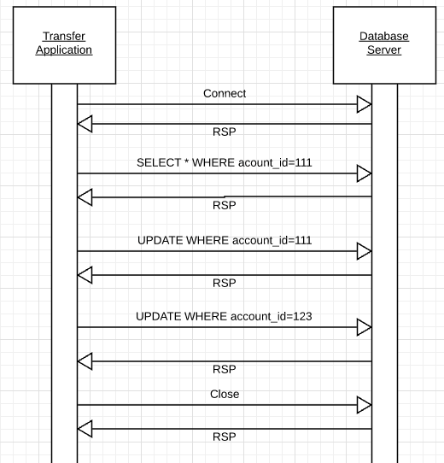
Isolation
Transfer $50 from
account_id=111 to
account_id=123
Requires 3 SQL statements
SELECT from 111 to check balance >= $50
UPDATE account_id=111
UPDATE account_id=123
There are some interesting scenarios
Two different programs read the balance ($51)
And decide removing $50 is OK.
DB constraints can prevent the conflict from happening, but …
There are more complex scenarios that constraints do not prevent.
Not ALL databases support constraints.
The “correct” execution should be that
One transaction responds “insufficient funds”
Before attempting transfer instead of after attempting.
Multiple readers

Slide 76
Isolation
Consider two simultaneous transfer transactions T1 and T2.
There are two equally correct executions
T1 transfers, T2 responds “insufficient funds” and does not attempt transfer
T2 transfers, T1 responds “insufficient funds” and does not attempt transfer
Each correct simultaneous execution is equivalent to a serial (sequential) execution schedule
(1) Execute T1, Execute T2
(2) Execute T2, Execute T1
NOTE:
We are focusing on correctness not
Fairness:
We do not care which transaction was actually submitted first.
And probably do not know due to networking, etc.
Transfer $50 from
account_id=111 to
account_id=123
Requires 3 SQL statements
SELECT from 111 to check balance >= $50
UPDATE account_id=111
UPDATE account_id=123
There are some interesting scenarios
Two different programs read the balance ($51)
And decide removing $50 is OK.
DB constraints can prevent the conflict from happening, but …
There are more complex scenarios that constraints do not prevent.
Not ALL databases support constraints.
The “correct” execution should be that
One transaction responds “insufficient funds”
Before attempting transfer instead of after attempting.
Multiple readers

Slide 77
Serializability
“In concurrency control of databases,^{[1][2]} transaction processing (transaction management), and various transactional applications (e.g., transactional memory^{[3]} and software transactional memory), both centralized and distributed, a transaction schedule is serializable if its outcome (e.g., the resulting database state) is equal to the outcome of its transactions executed serially, i.e. without overlapping in time. Transactions are normally executed concurrently (they overlap), since this is the most efficient way. Serializability is the major correctness criterion for concurrent transactions' executions. It is considered the highest level of isolation between transactions, and plays an essential role in concurrency control. As such it is supported in all general purpose database systems.” (https://en.wikipedia.org/wiki/Serializability)

Slide 78
DBMS ACID Implementation
Implementation Subsystems
Query processor schedules and executes queries.
Buffer manager controls reading/writing blocks/frames to/from disk.
Log manager journals/records events to disk (log), e.g.
Transaction start/commit/abort
Transaction update of a block and previous value of data.
Transaction manager coordinates query scheduling, buffer read/write and logging to ensure ACID.
Recovery manager processes log to ensure ACID even after transaction or system failures.
Log is a special type of block file used by the system to optimize performance and ensure ACID.
Garcia-Molina et al., p. 846

Slide 79
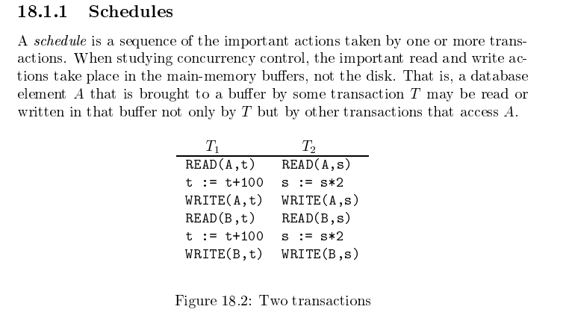
Schedule
Garcia-Molina et al.

Slide 80
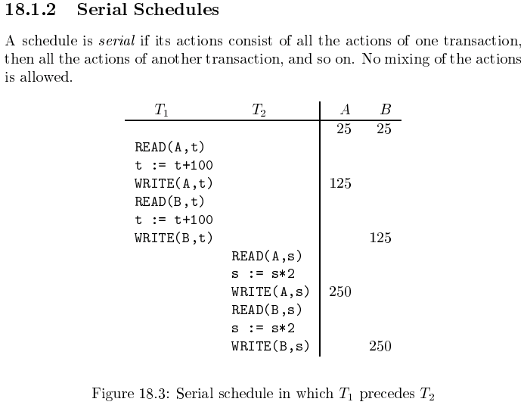
Serializable
Assume there are three
concurrently executing transactions
T1, T2 and T3
The transaction manager
Enables concurrent execution
But schedules individual operations
To ensure that the final DB state
Is equivalent to one of the following schedules
T1, T2, T3
T1, T3, T2
T2, T1, T3
T2, T3, T1
T3, T1, T2
T3, T2, T1
Concurrent execution was serializable.

Slide 81
Serializability (en.wikipedia.org/wiki/Serializability)
Serializability is used to keep the data in the data item in a consistent state. Serializability is a property of a transaction schedule (history). It relates to the isolation property of a database transaction.
Serializability of a schedule means equivalence (in the outcome, the database state, data values) to a serial schedule (i.e., sequential with no transaction overlap in time) with the same transactions. It is the major criterion for the correctness of concurrent transactions' schedule, and thus supported in all general purpose database systems.
The rationale behind serializability is the following:
If each transaction is correct by itself, i.e., meets certain integrity conditions,
then a schedule that comprises any serial execution of these transactions is correct (its transactions still meet their conditions):
"Serial" means that transactions do not overlap in time and cannot interfere with each other, i.e, complete isolation between each other exists.
Any order of the transactions is legitimate, (…)
As a result, a schedule that comprises any execution (not necessarily serial) that is equivalent (in its outcome) to any serial execution of these transactions, is correct.

Slide 82
Lock-Based Concurrency Control
Strict Two-phase Locking (Strict 2PL) Protocol:
Each Xact must obtain a S (shared) lock on object before reading, and an X (exclusive) lock on object before writing.
All locks held by a transaction are released when the transaction completes
(Non-strict) 2PL Variant: Release locks anytime, but cannot acquire locks after releasing any lock.
If an Xact holds an X lock on an object, no other Xact can get a lock (S or X) on that object.
Strict 2PL allows only serializable schedules.
Additionally, it simplifies transaction aborts
(Non-strict) 2PL also allows only serializable schedules, but involves more complex abort processing

Slide 83
Aborting a Transaction
If a transaction Ti is aborted, all its actions have to be undone. Not only that, if Tj reads an object last written by Ti, Tj must be aborted as well!
Most systems avoid such cascading aborts by releasing a transaction’s locks only at commit time.
If Ti writes an object, Tj can read this only after Ti commits.
In order to undo the actions of an aborted transaction, the DBMS maintains a log in which every write is recorded. This mechanism is also used to recover from system crashes: all active Xacts at the time of the crash are aborted when the system comes back up.

Slide 84
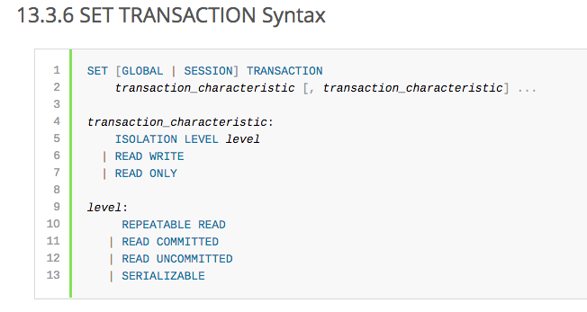
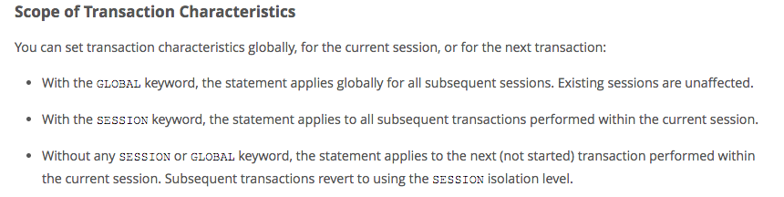
MySQL (Locking) Isolation

Slide 85
Isolation Levels (https://en.wikipedia.org/wiki/Isolation_(database_systems)
Not all transaction use cases require 2PL and serializable execution. Databases support a a set of levels.
Serializable
With a lock-based concurrency control DBMS implementation, serializability requires read and write locks (acquired on selected data) to be released at the end of the transaction. Also range-locks must be acquired when a SELECT query uses a ranged WHERE clause, especially to avoid the phantom reads phenomenon.
The execution of concurrent SQL-transactions at isolation level SERIALIZABLE is guaranteed to be serializable. A serializable execution is defined to be an execution of the operations of concurrently executing SQL-transactions that produces the same effect as some serial execution of those same SQL-transactions. A serial execution is one in which each SQL-transaction executes to completion before the next SQL-transaction begins.
Repeatable reads
In this isolation level, a lock-based concurrency control DBMS implementation keeps read and write locks (acquired on selected data) until the end of the transaction. However, range-locks are not managed, so phantom reads can occur.
Write skew is possible at this isolation level, a phenomenon where two writes are allowed to the same column(s) in a table by two different writers (who have previously read the columns they are updating), resulting in the column having data that is a mix of the two transactions.^{[3][4]}
Read committed
In this isolation level, a lock-based concurrency control DBMS implementation keeps write locks (acquired on selected data) until the end of the transaction, but read locks are released as soon as the SELECT operation is performed (so the non-repeatable reads phenomenon can occur in this isolation level). As in the previous level, range-locks are not managed.
Putting it in simpler words, read committed is an isolation level that guarantees that any data read is committed at the moment it is read. It simply restricts the reader from seeing any intermediate, uncommitted, 'dirty' read. It makes no promise whatsoever that if the transaction re-issues the read, it will find the same data; data is free to change after it is read.
Read uncommitted
This is the lowest isolation level. In this level, dirty reads are allowed, so one transaction may see not-yet-committed changes made by other transactions

Slide 86
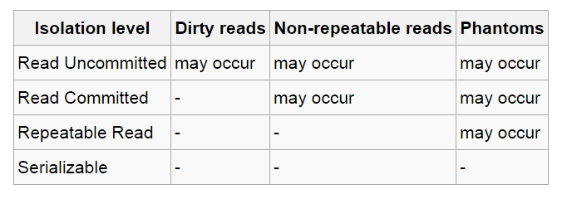
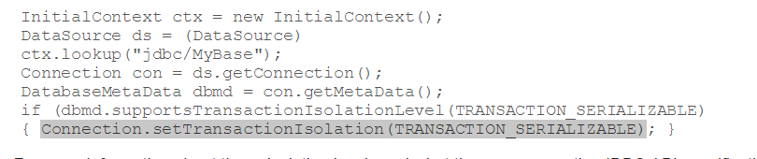
In Databases, Cursors Define Isolation
We have talked about ACID transactions
Atomic: A set of writes all occur or none occur.
Durable: The data “does not disappear,” e.g. write to disk.
Consistent: My applications move the database between consistent states, e.g. the transfer function works correctly.
Isolation
Determines what happens when two or more threads are manipulating the data at the same time.
And is defined relative to where cursors are and what they have touched.
Because the cursor movement determines what you are reading or have read.
But, … Cursors are client conversation state and cannot be used in REST.

Slide 87
Scalability Availability
87 | W4111-2024F-11-HW3b4b-Normalization-ModuleIV © Donald F. Ferguson, 2024

Slide 88
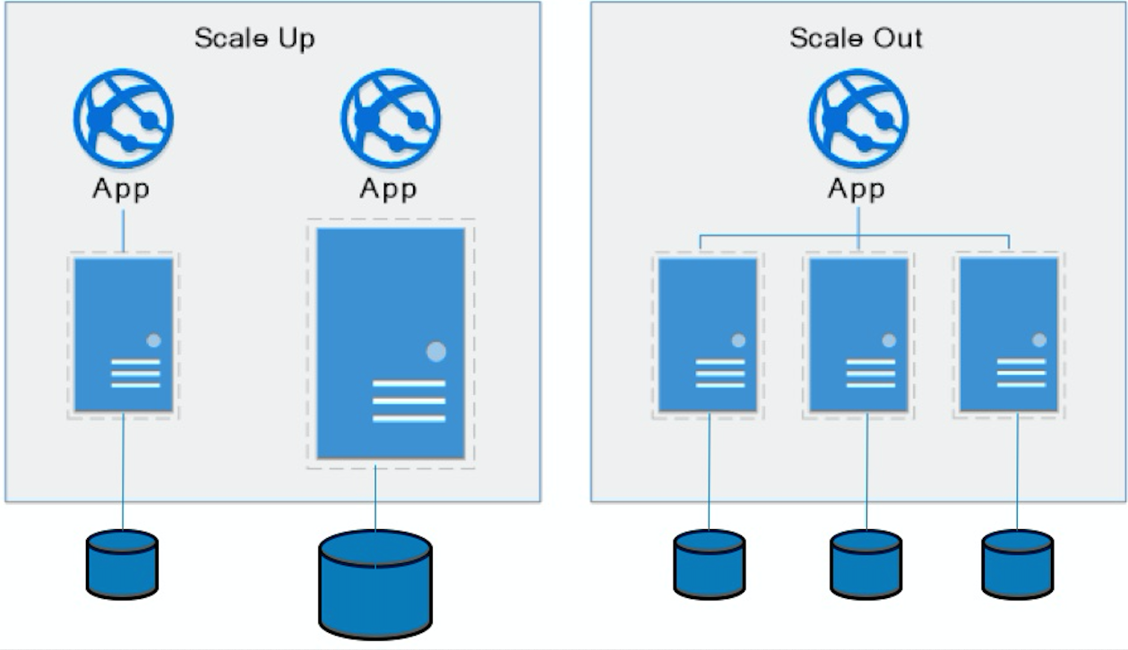
Approaches to Scalability
Scalability is the property of a system to handle a growing amount of work by adding resources to the system.
Replace system with a bigger machine, e.g. more memory, CPU, ... ...
Add another system.
Scale-up:
Less incremental.
More disruptive.
More expensive for extremely large systems.
Does not improve availability
Scale-out:
Incremental cost.
Data replication enables availability.
Does not work well for functions like JOIN, referential integrity, ... ...

Slide 89
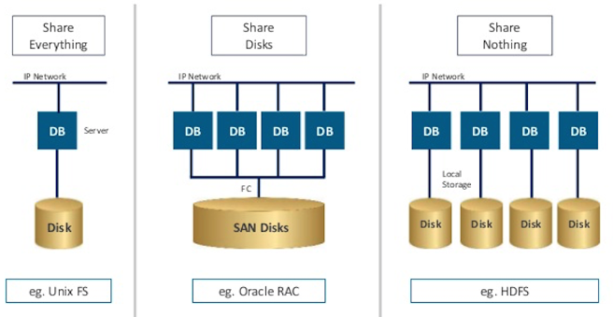
Disk Architecture for Scale-Out
Share disks:
Is basically scale-up for data/disks. You can use NAS, SAN and RAID.
Isolation/Integrity requires distributed locking to control access from multiple database servers.
Share nothing:
Is basically scale-out for disks.
Data is partitioned into shards based on a function f() applied to a key.
Can improve availability, at the code consistency, with data replication.
There is a router that sends requests to the proper shard based on the function.

Slide 90
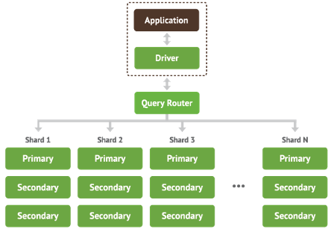
Shared Nothing, Scale-Out
MongoDB Sharding
DynamoDB Partitioning

Slide 91
Web Applications REST
91 | W4111-2024F-11-HW3b4b-Normalization-ModuleIV © Donald F. Ferguson, 2024

Slide 92
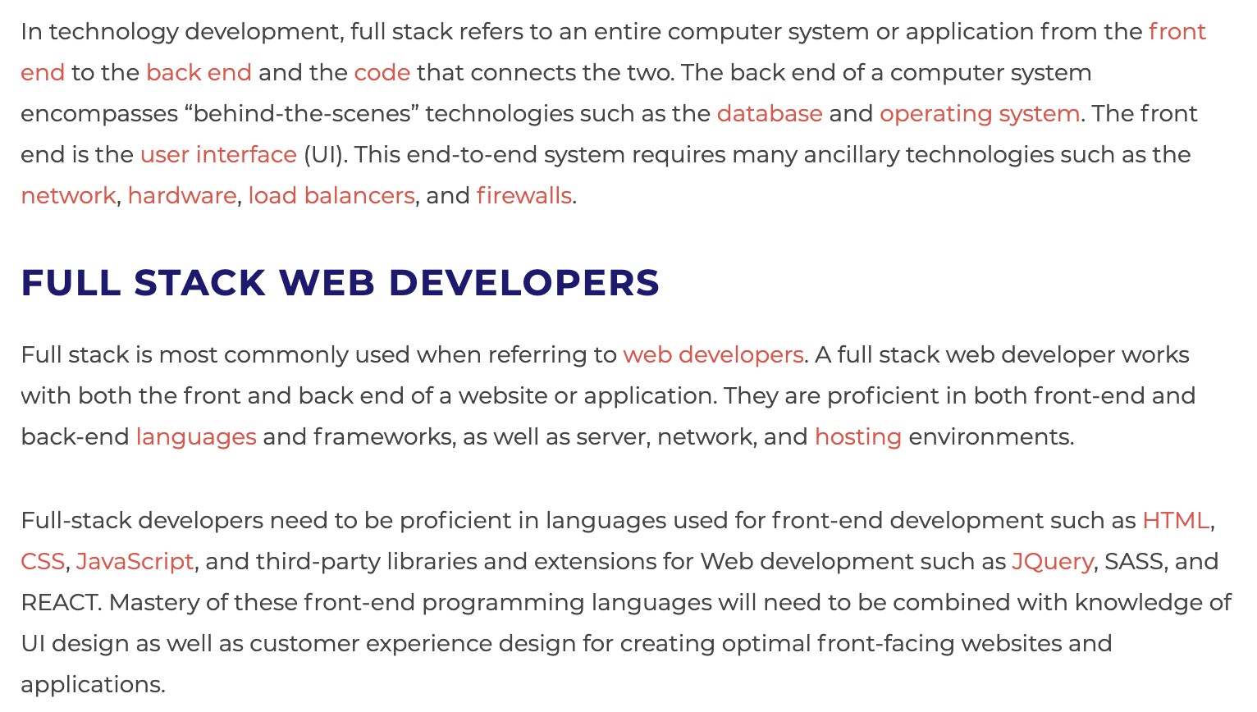
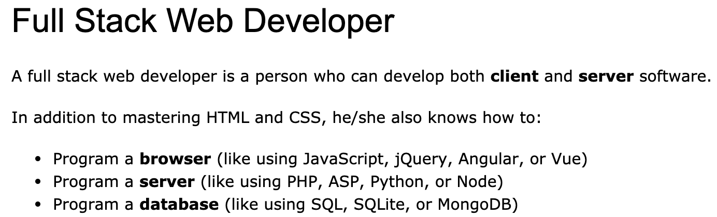
Full Stack Application
https://www.w3schools.com/whatis/whatis_fullstack.asp
There are courses that cover topics:
COMS W4153: Advanced Software Engineering
COMS W4111: Introduction to Databases
COMS W4170 - User Interface Design
This course will focus on cloud realization, microservices and application patterns, ... ...
Also, I am not great at UIs ... ... We will not emphasize or require a lot of UI work.
https://www.webopedia.com/definitions/full-stack/

Slide 93
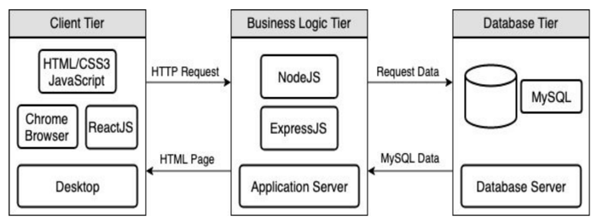
Full Stack Web Application
M = Mongo
E = Express
R = React
N = Node
I start with FastAPI and MySQL, but all the concepts are the same.
https://levelup.gitconnected.com/a-complete-guide-build-a-scalable-3-tier-architecture-with-mern-stack-es6-ca129d7df805
My preferences are to replace React with Angular, and Node with Flask.
There are three projects to design, develop, test, deploy, ... ...
Browser UI application.
Microservice.
Database.
We will initial have two deployments: local machine, virtual machine. We will ignore the database for step 1.

Slide 94
Some Terms
A web application server or web application framework: “A web framework (WF) or web application framework (WAF) is a software framework that is designed to support the development of web applications including web services, web resources, and web APIs. Web frameworks provide a standard way to build and deploy web applications on the World Wide Web. Web frameworks aim to automate the overhead associated with common activities performed in web development. For example, many web frameworks provide libraries for database access, templating frameworks, and session management, and they often promote code reuse.” (https://en.wikipedia.org/wiki/Web_framework)
REST: “REST (Representational State Transfer) is a software architectural style that was created to guide the design and development of the architecture for the World Wide Web. REST defines a set of constraints for how the architecture of a distributed, Internet-scale hypermedia system, such as the Web, should behave. The REST architectural style emphasises uniform interfaces, independent deployment of components, the scalability of interactions between them, and creating a layered architecture to promote caching to reduce user-perceived latency, enforce security, and encapsulate legacy systems.[1] REST has been employed throughout the software industry to create stateless, reliable web-based applications.” (https://en.wikipedia.org/wiki/REST)

Slide 95
Some Terms
OpenAPI: “The OpenAPI Specification, previously known as the Swagger Specification, is a specification for a machine-readable interface definition language for describing, producing, consuming and visualizing web services.” (https://en.wikipedia.org/wiki/OpenAPI_Specification)
Model: “A model represents an entity of our application domain with an associated type.” (https://medium.com/@nicola88/your-first-openapi-document-part-ii-data-model-52ee1d6503e0)
Routers: “What fastapi docs says about routers: If you are building an application or a web API, it’s rarely the case that you can put everything on a single file. FastAPI provides a convenience tool to structure your application while keeping all the flexibility.” (https://medium.com/@rushikeshnaik779/routers-in-fastapi-tutorial-2-adf3e505fdca)
Summary:
These are general concepts, and we will go into more detail in the semester.
FastAPI is a specific technology for Python.
There are many other frameworks applicable to Python, NodeJS/TypeScript, Go, C#, Java, … …
They all surface similar concepts with slightly different names.

Slide 96
REST (https://restfulapi.net/)
What is REST
REST is acronym for REpresentational State Transfer. It is architectural style for distributed hypermedia systems and was first presented by Roy Fielding in 2000 in his famous dissertation.
Like any other architectural style, REST also does have it’s own 6 guiding constraints which must be satisfied if an interface needs to be referred as RESTful. These principles are listed below.
Guiding Principles of REST
Client–server – By separating the user interface concerns from the data storage concerns, we improve the portability of the user interface across multiple platforms and improve scalability by simplifying the server components.
Stateless – Each request from client to server must contain all of the information necessary to understand the request, and cannot take advantage of any stored context on the server. Session state is therefore kept entirely on the client.
Cacheable – Cache constraints require that the data within a response to a request be implicitly or explicitly labeled as cacheable or non-cacheable. If a response is cacheable, then a client cache is given the right to reuse that response data for later, equivalent requests.
Uniform interface – By applying the software engineering principle of generality to the component interface, the overall system architecture is simplified and the visibility of interactions is improved. In order to obtain a uniform interface, multiple architectural constraints are needed to guide the behavior of components. REST is defined by four interface constraints: identification of resources; manipulation of resources through representations; self-descriptive messages; and, hypermedia as the engine of application state.
Layered system – The layered system style allows an architecture to be composed of hierarchical layers by constraining component behavior such that each component cannot “see” beyond the immediate layer with which they are interacting.
Code on demand (optional) – REST allows client functionality to be extended by downloading and executing code in the form of applets or scripts. This simplifies clients by reducing the number of features required to be pre-implemented.

Slide 97
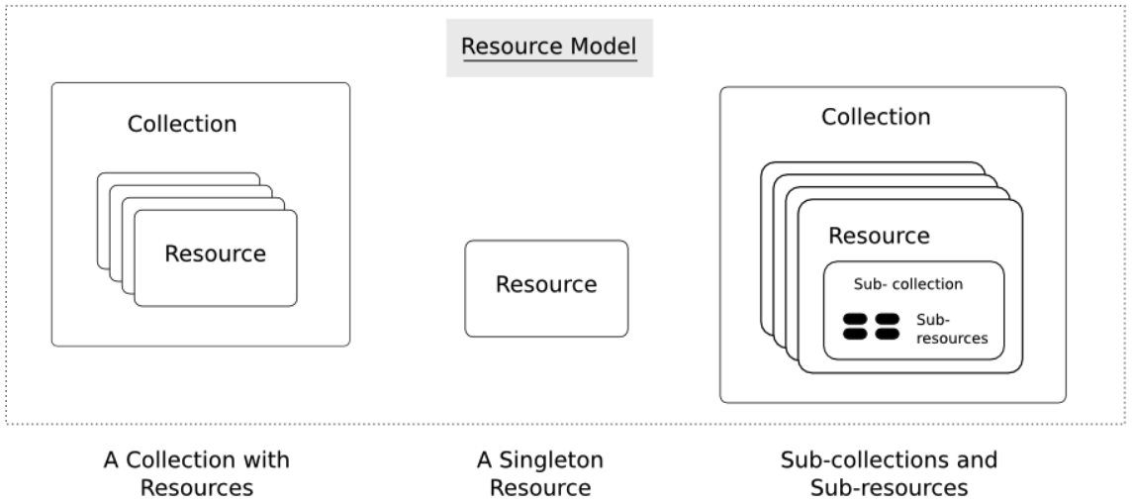
Resources
Resources are an abstraction. The application maps to create things and actions.
“A resource-oriented API is generally modeled as a resource hierarchy, where each node is either a simple resource or a collection resource. For convenience, they are often called a resource and a collection, respectively.
A collection contains a list of resources of the same type. For example, a user has a collection of contacts.
A resource has some state and zero or more sub-resources. Each sub-resource can be either a simple resource or a collection resource.
For example, Gmail API has a collection of users, each user has a collection of messages, a collection of threads, a collection of labels, a profile resource, and several setting resources.
While there is some conceptual alignment between storage systems and REST APIs, a service with a resource-oriented API is not necessarily a database, and has enormous flexibility in how it interprets resources and methods. For example, creating a calendar event (resource) may create additional events for attendees, send email invitations to attendees, reserve conference rooms, and update video conference schedules. (Emphasis added) (https://cloud.google.com/apis/design/resources#resources)
https://restful-api-design.readthedocs.io/en/latest/resources.html

Slide 98
REST – Resource Oriented
When writing applications, we are used to writing functions or methods:
openAccount(last_name, first_name, tax_payer_id)
account.deposit(deposit_amount)
account.close()
We can create and implement whatever functions we need.
REST only allows four methods:
POST: Create a resource
GET: Retrieve a resource
PUT: Update a resource
DELETE: Delete a resource
That’s it. That’s all you get.
A REST client needs no prior knowledge about how to interact with any particular application or server beyond a generic understanding of hypermedia.
“The key characteristic of a resource-oriented API is that it emphasizes resources (data model) over the methods performed on the resources (functionality). A typical resource-oriented API exposes a large number of resources with a small number of methods.” (https://cloud.google.com/apis/design/resources)

Slide 99
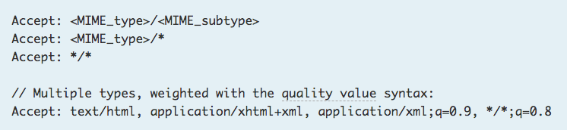
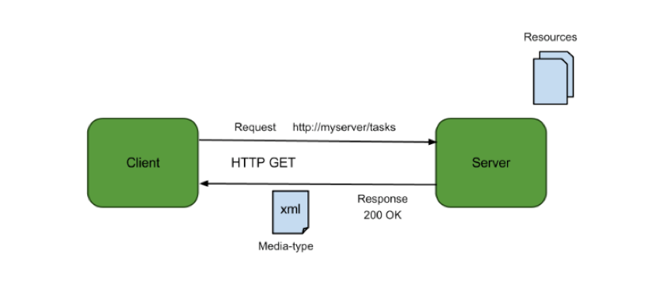
Resources, URLs, Content Types
Relative URL identifies “resource” on the server.
Server implementation maps abstract resource to tangible “thing,” file, DB row, … and any application logic.
Accept type in headers.
Client may be
Browser
Mobile device
Other REST Service
… …
Web media (content) type, e.g.
text/html
application/json

Slide 100
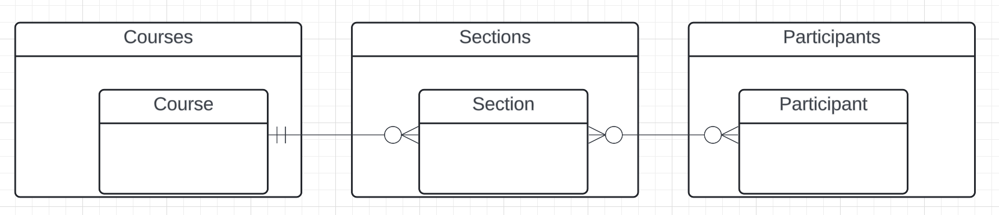
Resources and APIs
Base resources, paths and methods:
/courses: GET, POST
/courses/<id>: GET, PUT, DELETE
/sections: GET, POST
/sections/<id>: GET, PUT, DELETE
/participants: GET, POST
/participants/<id>: GET, PUT, DELETE
There are relative, navigation paths:
/courses/<id>/sections
/participants/<id>/sections
etc.
GET on resources that are collections may also have query parameters.
There are two approaches to defining API
Start with OpenAPI document and produce an implementation template.
Start with annotated code and generate API document.
In either approach, I start with models.
Also,
I lack the security permission to update CourseWorks.
I can choose to not surface the methods or raise and exception.

Slide 101
Data Modeling Concepts and REST
Almost any data model has the same core concepts:
Types and instances:
Entity Type: A definition of a type of thing with properties and relationships.
Entity Instance: A specific instantiation of the Entity Type
Entity Set Instance: An Entity Type that:
Has properties and relationships like any entity, but ...
Has at least one special relationship – contains.
Operations, minimally CRUD, that manipulate entity types and instances:
Create
Retrieve
Update
Delete
Reference/Identify/... ...
Host/database/table/pk

Slide 102
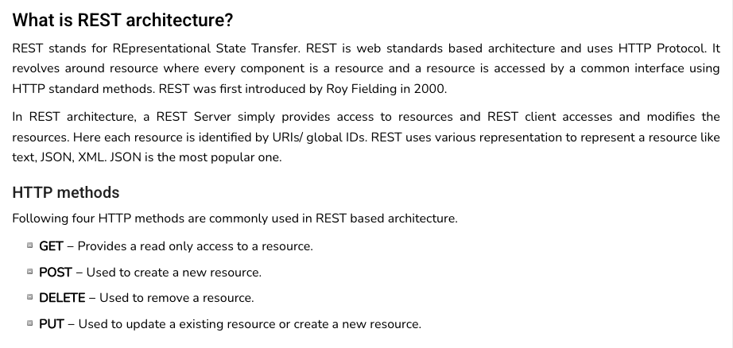
REST (https://www.tutorialspoint.com/restful/restful_introduction.htm)

Slide 103
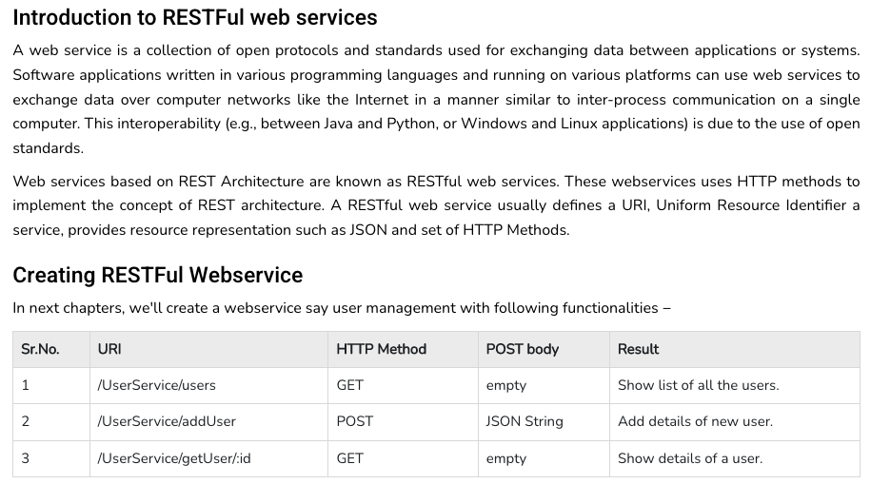
REST (https://www.tutorialspoint.com/restful/restful_introduction.htm)

Slide 104
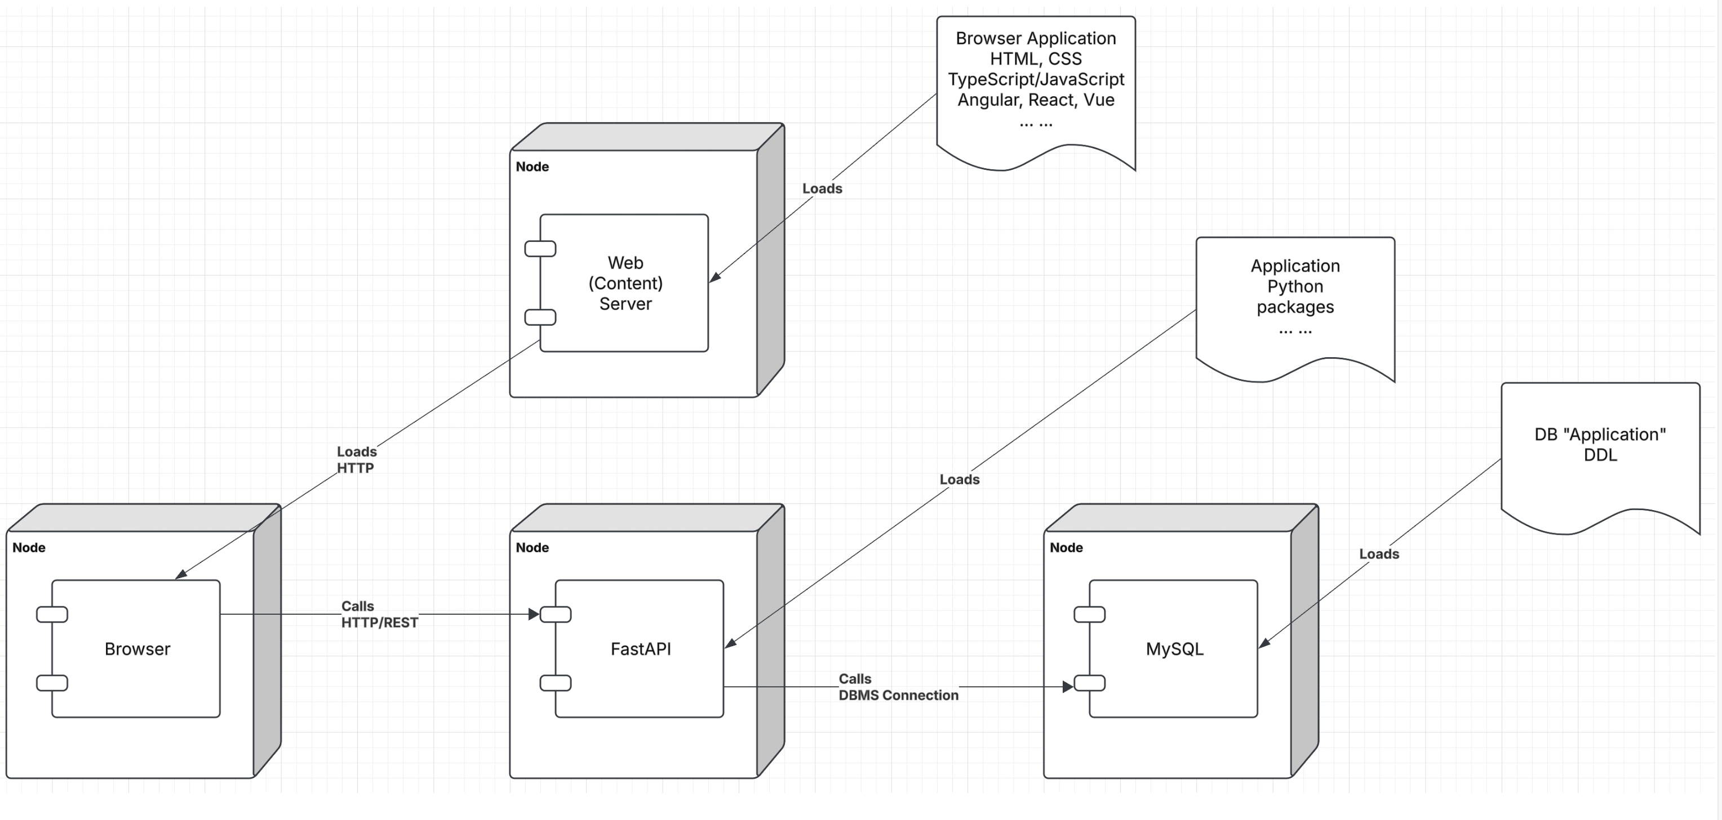
Let’s Look at the Programming Project

Slide 105
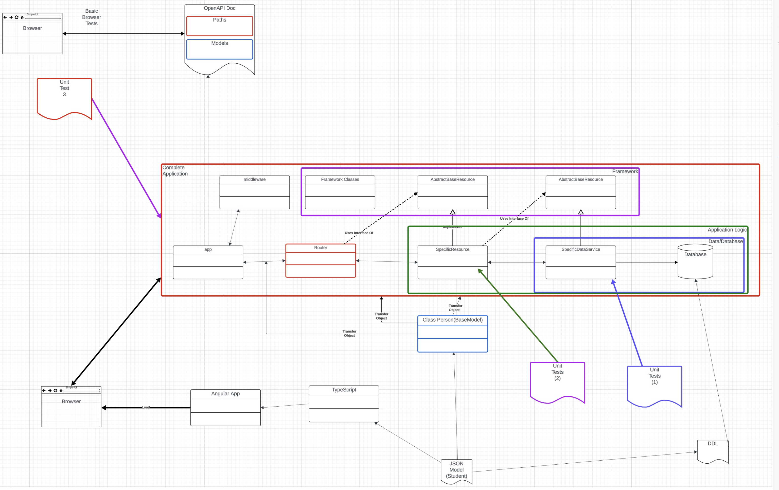
Let’s Look at the Programming Project

Slide 106
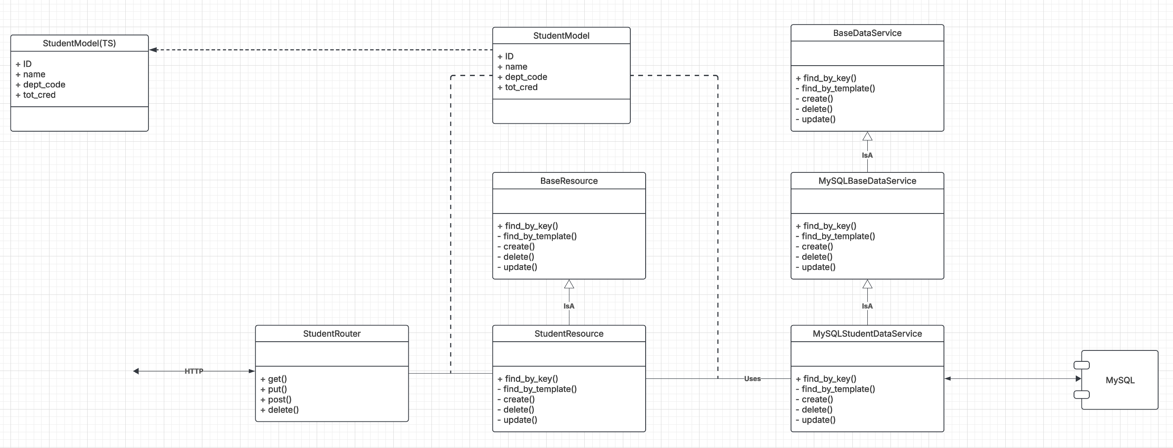
Let’s Look at the Programming Project

